Slide 1
Unit 2
Vocabulary Notes
[[Your Name Here]]
Notes:
Create Task Student Handouts

Slide 2
Unit 2.1 Word Ranking: How familiar are you with these words?
 | Not Familiar At All - I have never heard of this word. | Sort of Familiar - I have heard it before. | Really Familiar - I could teach someone else this word.
input
output
event
User Interface (UI)
algorithm
sequence
selection
repetition (or iteration)
pseudocode
Notes:
Copy and paste the check mark. You should have one check mark in each row.
This is also the unit overview reflection

Slide 3
Unit 2.1 Word Ranking: How familiar are you with these words?
 | Not Familiar At All - I have never heard of this word. | Sort of Familiar - I have heard it before. | Really Familiar - I could teach someone else this word.
If/else
conditional
Computing innovation
Pair programming
bits
bytes
Binary code
Computing device
The Internet
Notes:
Copy and paste the check mark. You should have one check mark in each row.

Slide 4
Unit 2.1 Word Ranking: How familiar are you with these words?
 | Not Familiar At All - I have never heard of this word. | Sort of Familiar - I have heard it before. | Really Familiar - I could teach someone else this word.
World Wide Web
protocol
The cloud
browser
component
sensor
collaboration
debugging
Notes:
Copy and paste the check mark. You should have one check mark in each row.

Slide 5
Unit 2.1 Word Ranking: How familiar are you with these words?
 | Not Familiar At All - I have never heard of this word. | Sort of Familiar - I have heard it before. | Really Familiar - I could teach someone else this word.
abstraction
Data abstraction
Procedural abstraction
representation
Binary number system
sequences
Decimal number system
hexadecimal
convert
Positional number system
Notes:
Copy and paste the check mark. You should have one check mark in each row.

Slide 6
Unit 2.1 Word Ranking: How familiar are you with these words?
 | Not Familiar At All - I have never heard of this word. | Sort of Familiar - I have heard it before. | Really Familiar - I could teach someone else this word.
Logic gates
AND gate
OR gate
NOT gate
Boolean
Flip flop
Hardware abstractions
Moore’s Law
data
Notes:
Copy and paste the check mark. You should have one check mark in each row.

Slide 7
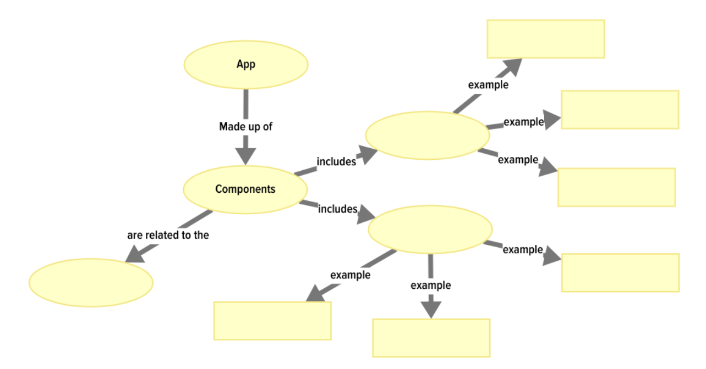
Unit 2.2
Add the following words to the concept map
After that, add your own examples in the rectangles. Once all of the blank shapes are completed, where could you add Event-Driven Programming? What is it most related to?
Input | Output | User Interface
Then, add your own examples in the rectangles.

Slide 8
Unit 2.3
Use the 2.3 lesson page to find and write down the definition and examples of each vocab word:
Word | Definition | Example(s) / Images / Links | Everyday Connections from Your Own Life
algorithm
sequence
selection
repetition (or iteration)
pseudocode

Slide 9
Unit 2.4
Describe a process within your favorite app using these key vocabulary words.
if/else | conditional
One process that occurs in my favorite app is…
During that process...

Slide 10
Unit 2.5
Use the following words to explain how data can be represented using bits.
Word Bank:
Binary code
Os and 1s
bytes
memory
Binary digit
You can select a sentence stem to help you share your thoughts:
________________ because _______________.
Because ________________ , _______________.
Since _____________, __________________
________________, therefore _______________.
______________, consequently _____________.
___________ leads to______________ .
Type answer here

Slide 11
Give an example of a special purpose computer that you are familiar with and briefly describe its hardware and its software.
Word Bank:
Hardware | Software | Input | Output | Program
One example of a special purpose computer is…
One way the hardware and software work together is...
Notes:
When you are finished, you can use your answer from this prompt to help you with your answer to 2.5 Reflection question #1.

Slide 12
Unit 2.6
Sentence Deconstruction
In order to better understand the following sentence from the 2.6 POGIL activity, replace each underlined word with a related, more well-known word. Then, write a new version of the sentence using the new words in place of the underlined words..
Responsible programmers try to consider the unintended ways their computing innovations can be used and the potential beneficial and harmful effects of these new uses...
Write your new version of the sentence here:
Responsible programmers try to consider
the unintended ways their computing innovations can be used
and the potential beneficial and harmful effects of these new uses.
responsible = ________
consider = ________
unintended =________
potential = ________
beneficial = ________
harmful = ________
effects = ________
Notes:
Click here for additional sentence deconstruction slides and examples

Slide 13
Unit 2.7 - Sequence Flow Map
This graphic organizer can help you to organize your thoughts when describing how you created the I Have a Dream App, or when planning out your I Have a Dream enhancements or Soundboard app.
Notes for
UI and/or Code Blocks
Description
Step
First
Next
After that
Last
Notes:
Additional sentence starters and supports:
The first thing that we did to create the I Have a Dream app was…
The next thing that we did was…
After that we….
Then we….
The last step to create the I Have a Dream app was…

Slide 14
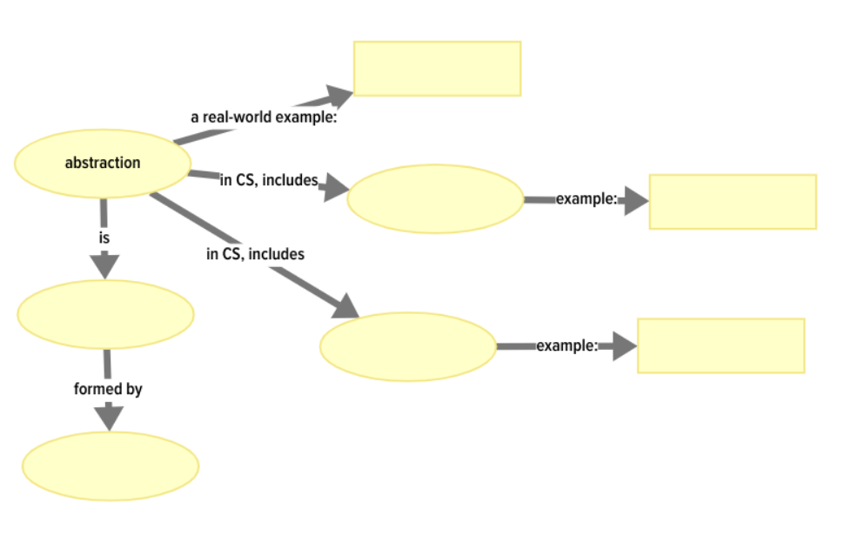
Unit 2.8
Use the following words/phrases to fill out this concept map.
representation
Including only necessary details
general
Procedural abstraction
Data abstraction
Then, add your own examples in the rectangles.

Slide 15
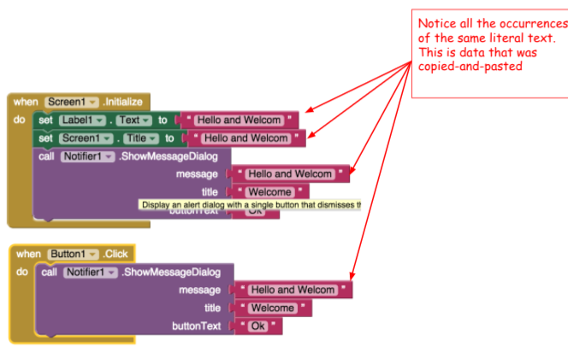
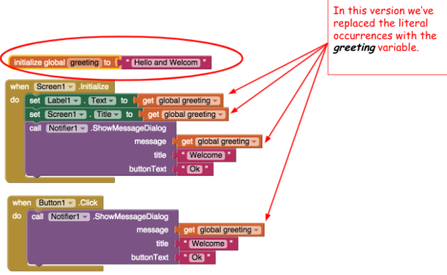
Explain the difference between these two programs. How is this an example of data abstraction?
(there are sentence stems in the speaker notes that you can use to help you share your thoughts)
Program A
Program B
Notes:
You can use sentence stems to help you share the differences between the two programs:
__________ and __________ are different because ____________.
__________ is ___________, but ___________ is ____________.
__________ and __________ differ because ____________.
__________ has/is _________, yet __________ has/is____________.
_________ is ________. On the other hand, ________ is _________.
You can use these sentence stems to help you share how this is an example of data abstraction:
________________ , so _______________.
________________ because _______________.
Because ________________ , _______________.
Since _____________, __________________
________________, therefore _______________.
______________, consequently _____________.
___________ led to______________ .
As a result of ____________, ______________ .

Slide 16
Unit 2.9 - Chunk the Text
This word problem from the 2.9 reflection questions includes several details. In order to help ensure that you understand the question, use the Chunk the Text strategy to read each sentence line-by-line, and highlight important details, or take notes. The first line has some important details already highlighted as an example. Once you understand the question and details, you can complete the problem and add your answers to your reflection portfolio for 2.9 #4.
Sentence | Notes
Each student that enrolls at a school is assigned a unique ID number, which is stored as a binary number.
The ID numbers increase sequentially by 1 with each newly enrolled student.
If the ID number assigned to the last student who enrolled was the binary number 1001 0011, what binary number will be assigned to the next student who enrolls?
What number will be assigned to the 10th student after the number 1001 0011 is assigned?
Notes:
When you are finished, you can use your answer from this prompt to help you with your answer to 2.9 Reflection Question #4.

Slide 17
Matching Activity
Match the technical terms with their definitions
Unit 2.10
Technical Term | Definition or description
RAM | A gate is a tiny electronic circuit that performs a basic logic operation.
CPU | A logic abstraction that defines the behavior of a gate.
Gate | Electronic component that corresponds to a logic element that is TRUE when either or both of its inputs, A and B, are TRUE.
Truth table | Stores the computer's programs and data temporarily while power is on
AND Gate | The process of leaving out details in order to represent a concept.
OR Gate | A two-state circuit that can store 1 bit of binary information.
Abstracting | Electronic component that corresponds to a logic element that is TRUE only when both of its inputs, A, and B, are TRUE.
Flip flop | Performs the fetch/execute cycle to run machine language programs.
Notes:
Taken from 2.10 lecture slides:
https://docs.google.com/presentation/d/1yHx42yEaUzLurEuBOzQWvb0KS3oBsM7xhDh2lETod3M/edit#slide=id.g35d7cec34_8285

Slide 18
Unit 2.11
Identify three things around you that process digital data, or bits. Describe the devices and the inputs and outputs for the digital data.
You can use sentence stems to help you share your thoughts:
One thing in my classroom that uses bits is….
The digital input to that device is...
The output from the device is….
Another device that processes digital data is...
Type your answer here.

